Slide 1

Microsoft Azure Developer: Implement Secure Cloud Solutions
Implement Solutions That Interact with Microsoft Graph
Reza Salehi
CLOUD CONSULTANT
@zaalion

Slide 2
Introduction to Microsoft Graph
Using Microsoft Graph
Demo: Graph Explorer
Demo: Use Microsoft Graph in a .NET app
Using the Graph .NET SDK
Overview

Slide 3
Introducing Microsoft Graph

Slide 4
Microsoft Graph
Microsoft Graph is the gateway to data and intelligence in Microsoft 365, Windows 10 and Enterprise Mobility + Security.

Slide 5
Microsoft Graph Can Work With
Office 365
Windows 10
Enterprise Mobility + Security
Excel
Calendar
Mail

Slide 6
Microsoft Graph
Provides a unified programming model that you can use to access data in Microsoft 365, Windows 10, and Enterprise Mobility + Security.

Slide 7
Treat Office 365 information as data, query it and write to it!

Slide 8
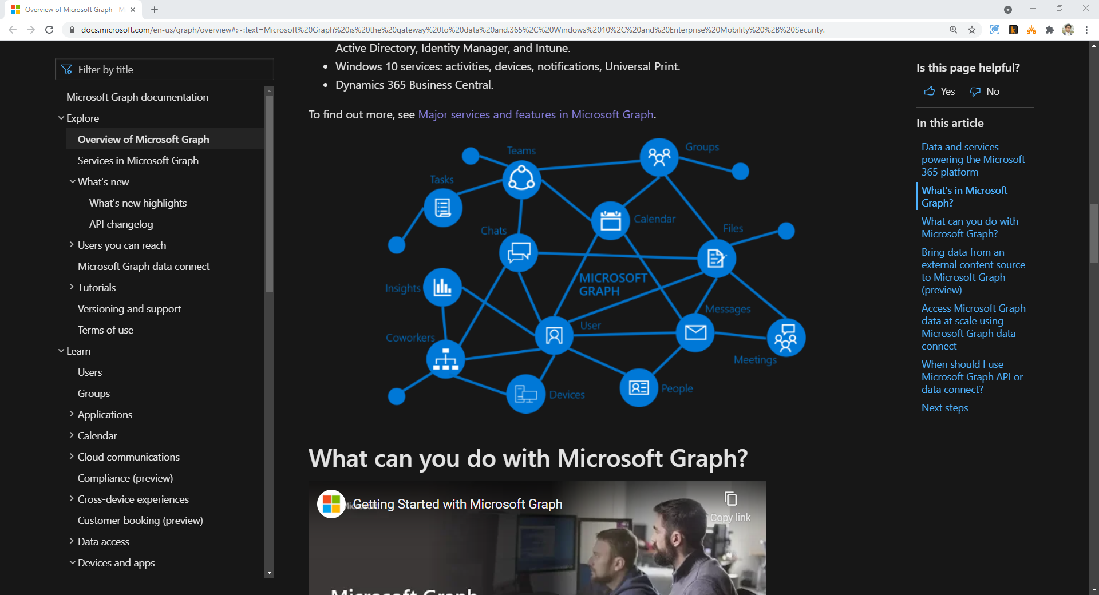
https://docs.microsoft.com/en-us/graph/overview

Slide 9



Microsoft Graph
Use a single endpoint, https://graph.microsoft.com, to access data and insights in the Microsoft cloud
Including Microsoft 365, Windows 10, and Enterprise Mobility + Security.
Use REST APIs or SDKs to access the endpoint and build apps that support Microsoft 365 scenarios

Slide 10
Microsoft Graph
Microsoft 365 core services
Enterprise Mobility + Security services
Windows 10 services
Dynamics 365 Business Central

Slide 11
Microsoft 365 Core Services
Bookings
Teams
OneDrive
OneNote
Outlook and Exchange
SharePoint

Slide 12
Enterprise Mobility + Security Services
Advanced Threat Analytics
Advanced Threat Protection
Azure Active Directory, Identity Manager, and Intune

Slide 13
Windows 10 Services
Activities
Devices
Notifications
Universal Print

Slide 14
Dynamics 365 Business Central
Management of financial data
Automation and securing of the supply chain
Sales management
Management of projects
Optimization of operations
Improved customer service

Slide 15




You Can Develop an App Which
Looks at your next meeting and provides profile information of the attendees
Scans your calendar, and suggests time slots for the next meeting
Creates an automated bot for Microsoft Teams
Subscribes to changes in your calendar, sends an alert when you’re spending too much time in meetings

Slide 16
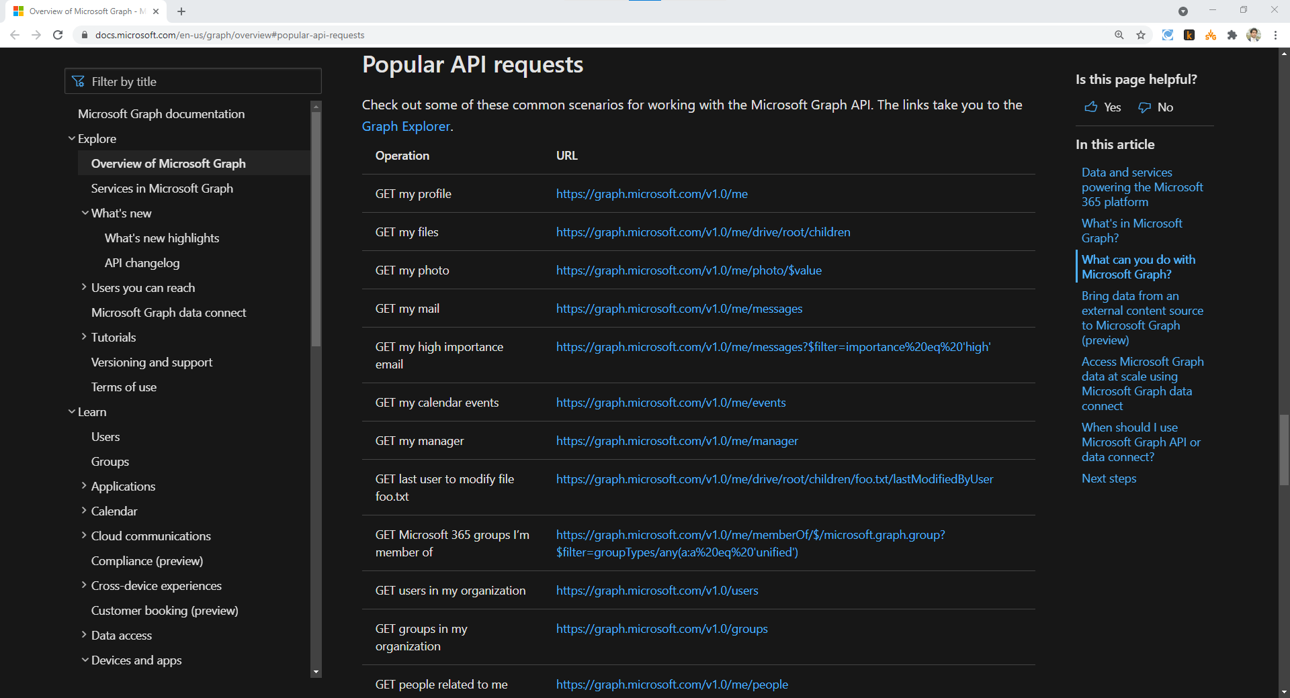
https://docs.microsoft.com/en-us/graph/overview#popular-api-requests

Slide 17
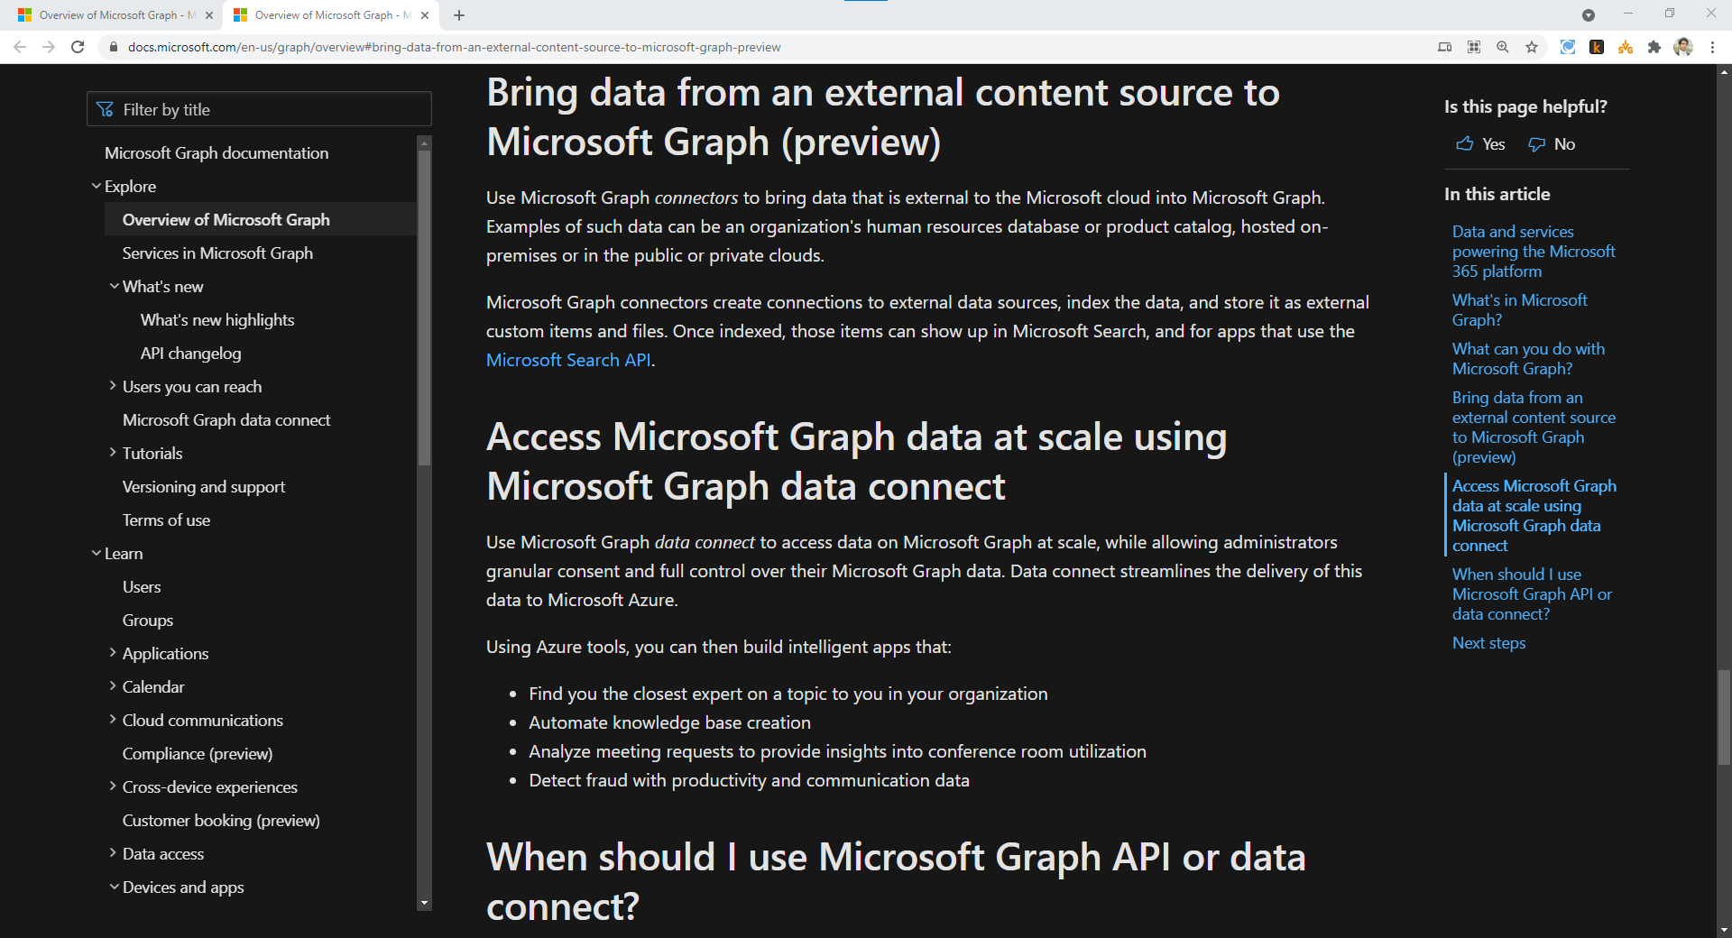
https://docs.microsoft.com/en-us/graph/overview#bring-data-from-an-external-content-source-to-microsoft-graph-preview

Slide 18
Working with Microsoft Graph

Slide 19
Some Microsoft Graph APIs are only available with a work, school or developer account.

Slide 20
However, you can still test a subset of Graph APIs using free Microsoft accounts.

Slide 21
Working with Microsoft Graph
REST APIs
SDKs

Slide 22
https://docs.microsoft.com/en-us/graph/overview#popular-api-requests

Slide 23
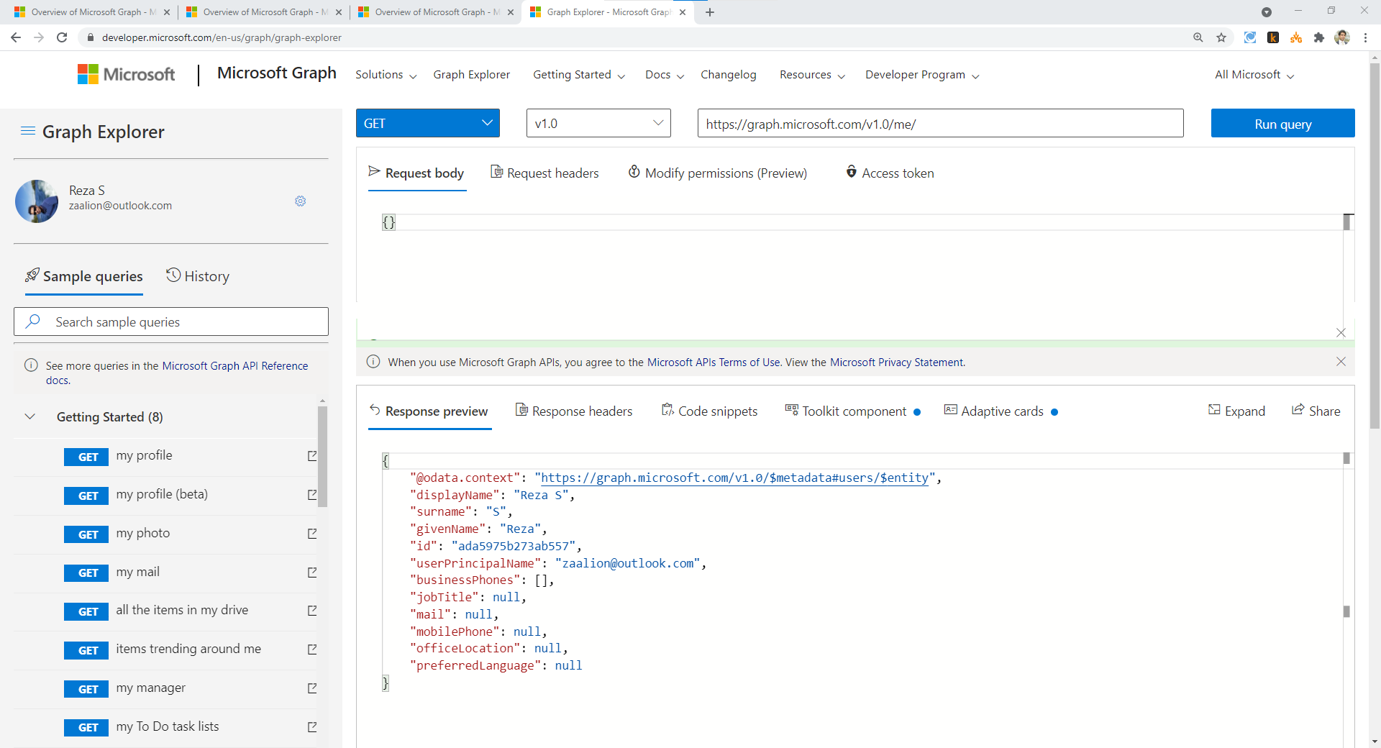
https://graph.microsoft.com

Slide 24
Microsoft Graph SDKs
Android
Angular
ASP.NET
iOS
JavaScript
Node.js
Java
PHP
Python
Ruby
PowerShell
Azure CLI

Slide 25
Microsoft recommends getting a free Microsoft 365 developer subscription by signing up for the Microsoft 365 Developer Program when building applications using Microsoft Graph.

Slide 26
Graph Explorer

Slide 27
Using the Graph .NET SDK

Slide 28
Introduction to Microsoft Graph
Using Microsoft Graph
Demo: Graph Explorer
Demo: Using the Graph .NET SDK
Summary

